Slide 1
Financial & Economic Situation
Where We Have Been
Where We Are
Where We Are Going

Slide 2
Stock Crashes in 20th and 21rst Centuries

Slide 3
U.S. Stock Crashes and Macroeconomic Events

Slide 4

Income & Debt Constraints
Infinite Horizon Economy Budget Constraint:
PV Income + PV Debt = Debt Service + PV Consumption
“NPG” Condition: Over the long run income funds consumption (not debt)
  Entire economy faces a budget constraint just as households or government
  Sustainable Long Run Relationship:
    Income – Consumption – Debt Service>=0

Slide 5
Can Financial Events Cause
Macroeconomic Problems?
Valuation of Stock, Debt (Firm Value)
  PV = Expected ∑ {Earnings/(1+r)}
  High valuations with either high earnings expected or low risk expected (low discounts)
  Values in traded exchanges or part of story
Impacts of large overvaluations:
  Payments crisis
  Consumption/Investment effects
    Wealth (balance sheet) effects
    Debt/Income ratios

Slide 6
High Valuations: (Leverage in different forms)
1920s Equity “Bubble, 2000s Debt “Bubble”
JC: “If we tried to hold equity or corporate debt in highly leveraged entities funded by short-term debt, we would have the same problems. Actually, we did, back in the 1930s.”
“Leverage” often used as synonym for debt, but, equity can be overvalued and lead to financial pinches when it falls in value by large amounts; regardless of debt v. equity, the long run value is PV of income from them (Modigliani-Miller)
Consider 2 Scenarios for City Center (at $10T nominal value)
  Case 1: $9T in Shareholder Equity with $1T in bank debt;
  Case 2: $1T in Shareholder Equity with $9T in bank debt:
  Assume “true” PV of future income = $5T
  With project default:
  Case 1: Bank takes residual value = $1T
    Original shareholders lose $9T
    New shares issued worth $4T
    Loss in balance sheets = $5T
  Case 2: Bank takes residual value = $1T
    Shareholders lose $1T
    Bank loses $8T in value up front; issues new stock and regains $4T
    Loss in balance sheets =$5T
  In both cases, balance sheets over-valued by $5T; purchases made with this “leveraged”

Slide 7
1920s: Stock (equity) Valuations Not Sustainable
(beginning month = 1.0)

Slide 8
2008 Crisis & Aftermath
Cause/Effect
  What is the gasoline, what is the match?
    “Root causes” v. “Point-of-failure” causes versus “root causes”
  Fed/Treasury actions
    Water or gasoline?

Slide 9
2008 Root Cause?
Debt Values Unsustainable

Slide 10

“Poster” for Huge Non-Mortgage Debt
$11 Billion City Center Project
Las Vegas – MGM Mirage
Bank Loan/Bond Funded

Slide 11
How Much is Too Much?
Debt-Income Ratios in Simulations

Slide 12
Mortgage Debt only Part of the Story:
Commercial Lending a Bigger Part

Slide 13
Debt Growth in 2000s High Relative to Prior (growing) Trend

Slide 14
Common Explanations
Moral Hazard-“Too Big to Fail”
  Point-of-failure: Uncertainty about Fed action created spark
  Long run problem: Fed guarantees, separating “systemic” v. non-systemic problems and some by instruments that veiled genuine risks
  Taylor variant: Fed supplied too much money to markets in early 2000s
  Variant: point of failure problems enhanced/created by MTM
Hamilton: Above may be true but partial
  Point-of-Failure: Oil prices summer of 2008
  Long run: huge increases in mortgage debt put system at risk; much more vulnerable to point-of-failure issues

Slide 15
Role of Moral Hazard/Policy Uncertainty
Moral Hazard Thesis
  Long Run: Existence of Fed creates a moral hazard; greater risk taken in banking/finance sector
    Cochrane: bank run externality requires something like Fed, and some moral hazard
    Moral hazard too great because market expects Fed to cover everything (over given size)
    Incremental impact of moral hazard?
      Private firms/stockholders/execs bore a huge cost, even if not all the cost
    Isn’t this tradeoff of having a Fed as Lender of Last Resort (insurer)?
Policy Uncertainty Thesis
  Short Run: policy uncertainty is the match
    In Sept 08, Fed let’s Lehman fail, saves AIG
    Spurs crisis by statements about conditions
    Prisoner’s dilemma for Fed

Slide 16
Evaluating “Policy Uncertainty” Thesis:
Financial Stress Appearing Long Before Sept 08

Slide 17
Why So Much Attention on Mortgage Debt?
See mortgage debt as leading indicator, not as only cause
  Fire analogy: room with fire in it first does not tell you about the fuel and match
Mortgage debt securitized-tradeable;
  Quickly reflecting change in valuations
Commercial bank loans non-tradeable;
  Held at bank estimated values for longer

Slide 18
Causes of Debt/GDP Expansion:
Cheap Credit

Slide 19
Cheap Credit:
Fed Responsible?

Slide 20
Cheap Credit:
Public Sector Supply

Slide 21
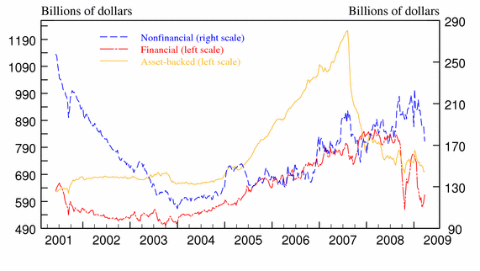
Cheap Credit:
Private Sector Supply

Slide 22
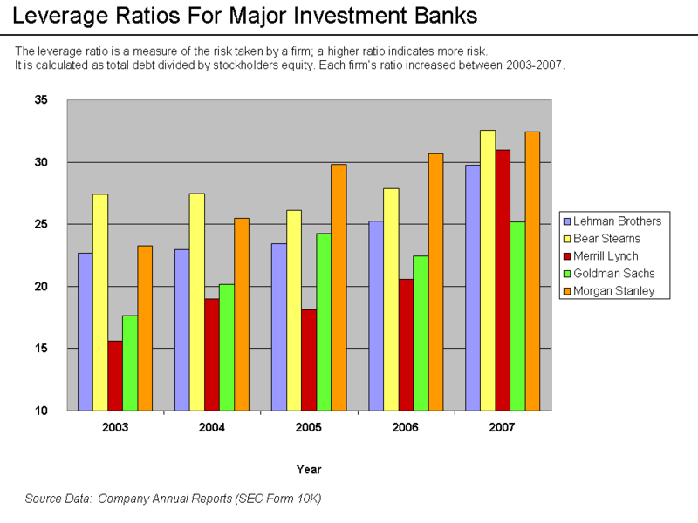
Cheap Credit:
Increasing Leverage

Slide 23
Cheap Credit:
Inflow of Foreign Capital

Slide 24
Role of Foreign Capital?

Slide 25
Cheap Credit:
Innovations?
Securitization, e.g. CDOs
  Pooling mortgage (other debt) risk (CDOs, SPVs)
Credit Insurance
  Transferring Risk (CDS)
Cochrane: can shuffle risk around, but not change total amount
Evaluation:
  CDOs, CDS actually relatively small versus size of overall debt growth

Slide 26
Marked-to-Market Accounting?
How big of an effect is possible from MTM pricing of banks?
See SEC Dec. 2008 Study www.sec.gov/news/studies/2008/marktomarket123008.pdf
  31% of bank assets MTM
    22% of these impact income statement
    Part of this amount in Treasuries
Differences in MTM and “amortized cost”
  If 20% difference, then 4.4% impact on income
  Currently, using “amortized cost” method
    Citi assets increase by apx. $3B (out of $1.2T)
    BoA assets increase by apx. $9B (out of $1.4T)

Slide 27
Solutions?
Cochrane:
  Specify systemic risk for Fed, limiting TBTF
Stiglitz, …
  Limit financial innovation
  More stringent oversight
Poole, Bullard, BG, …
  Raise equity standards
  Limit financial firm size
    Charge insurance fee based on size
    Explicit size limitations

Slide 28
Debt-GDP Ratios 20s/30s v. 2000s

Slide 29
Higher Equity Standards the answer?
Modigliani-Miller Theorem: Capital Structure Irrelevance
No difference of debt v. equity (ownership shares) financing of projects if
  Asset prices move with statistical independence;
  Asset prices are information based without systematic errors;
  Taxes treatment of both sources is the same
  Bankruptcy treatment of both is the same
  No asymmetry of knowledge among borrowers, lenders, shareholders
Implies capital structure matters to the degree that these conditions matter

